Slide 1
Day 9

Slide 2
HPCToolkit

Slide 3
Agenda
Introduction
HPCToolkit workflow
Running matrix multiplication using HPCToolkit

Slide 4
HPCToolkit
Tools for tracing, profiling and analyzing parallel programs
Measure program's amount of work and resource consumption, metrics such as CPUTIME, FLOPS, CACHE MISSES, MEMORY LEAK
Pinpoint hotspots
Determine whether a program is I/O bound, memory bound, or compute bound

Slide 5
Features
Sampling-Based Profiling: Uses sampling to gather performance data, reducing the overhead compared to instrumentation
Call Path Profiling: Captures and analyzes calling context information, allowing users to see how routines are called and their performance impact within the program's call hierarchy
Scalability: Designed to scale to large HPC systems, capable of analyzing applications running on thousands of cores
Data collection: Collects performance metrics such as CPU utilization, memory usage, and I/O operations.

Slide 6
Performance metrics
CPU time and cycles
Instructions per cycle
Cache misses
Memory bandwidth
I/O operations

Slide 7
Installing hpctoolkit using spack
source setup-env.sh file
spack list | grep hpctoolkit
spack find hpctoolkit
spack info hpctoolkit
spack install -v -j40 hpctoolkit
spack load hpctoolkit

Slide 8
Running program with HPCToolkit
hpcrun
hpcstruct
hpcprof
hpcviewer

Slide 9
Running program with HPCToolkit - hpcrun
hpcrun is the command used to collect performance data while an application is running
It performs sampling-based profiling, which reduces the overhead compared to instrumentation-based methods

Slide 10
Running program with HPCToolkit - hpcrun
hpcrun [options] <application>
options:
-e <event>: Specifies the hardware event to sample (e.g., REALTIME, CYCLES, MEMORY LEAK, CACHE MISSES)
-t: Enables tracing of function call entry and exit.
-o <directory>: Specifies the output directory for storing performance data.
-u <interval>: Sets the sampling interval (e.g., 100ms)
Eg. hpcrun -e REALTIME -o hpctoolkit-measurements ./my_application
It will generate a measurement directory

Slide 11
Running program with HPCToolkit - hpcrun
Events list
hpcrun -L

Slide 12
Running program with HPCToolkit - hpcstruct
hpcstruct analyzes the application binary and constructs a program structure
It recovers program structure about lines, loops and functions (information)

Slide 13
Running program with HPCToolkit - hpcstruct
hpcstruct <measurement_directory>
It will generate a struct file in the measurement directory

Slide 14
Running program with HPCToolkit - hpcprof
hpcprof correlates the performance data collected by hpcrun with the program structure generated by hpcstruct
it produces a database of performance metrics that can be visualized

Slide 15
Running program with HPCToolkit - hpcprof
hpcprof <measurement_directory>

Slide 16
Running program with HPCToolkit - hpcviewer
hpcviewer is a graphical user interface for exploring the performance data
It visualizes the performance metrics and allows users to navigate through the hierarchical structure of the program to identify hotspots and bottlenecks.
hpcviewer <database_directory>

Slide 17
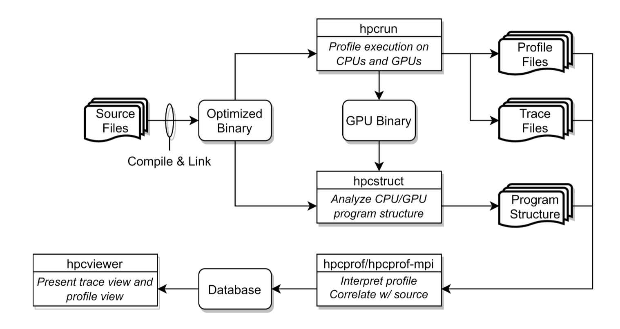
HPCToolkit workflow

Slide 18
Running matrix multiplication program
Step 1 : measure an execution of matrix multiplication
hpcrun -e REALTIME -t ./row_wise_matrix_hpctoolkit
Step 2 : compute program structure information
hpcstruct hpctoolkit-row_wise_matrix_hpctoolkit-measurements/
Step 3 : combine measurement data with program structure information
hpcprof hpctoolkit-row_wise_matrix_hpctoolkit-measurements
Step 4 : view the kernel-level profile and trace data
hpcviewer hpctoolkit-row_wise_matrix_hpctoolkit-database/

